Slide 1
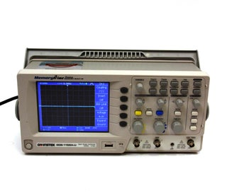

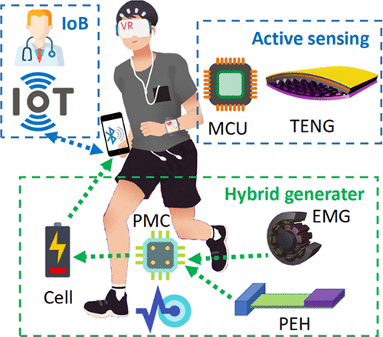
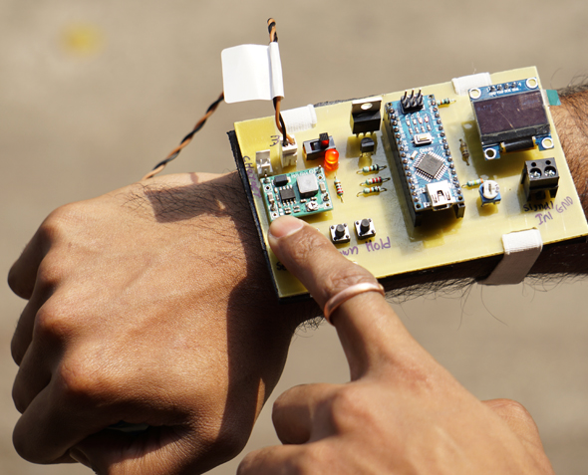
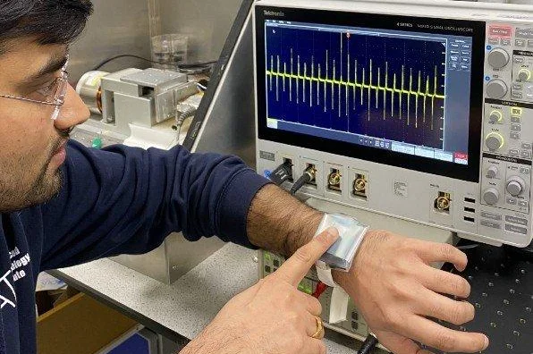
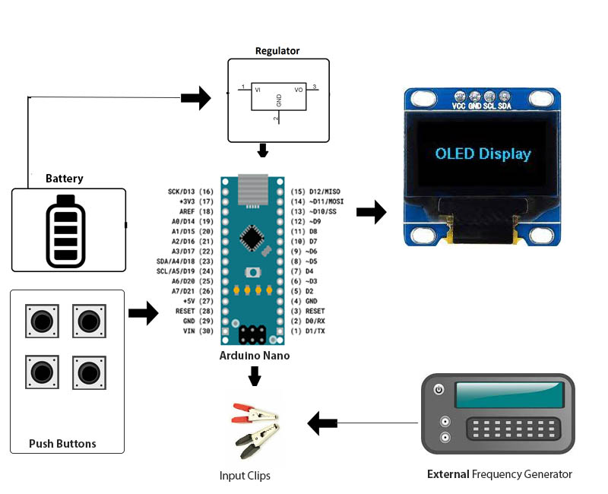
WEARABLE OSCILLOSCOPE
SUSTAINABLE DEVELOPMENT GOAL PROJECT
sdsssssjtt
COMPONENTS:
Arduino,OLED display,battery,push buttons,LED’S,PCB board,Resistor, Capacitor,Transistors
APPLICATIONS:
Used in electronics troubleshooting and hobbyist electronics projects.
USES:
It allows users to visualize and analyze electrical signals and waveforms.
HARDWARE AND SOFTWARE REQUIRED:
Arduino,
Soldering Kit,
Soldering Metal Wire.
PRESENTED BY:
E.G.PRADEEP
M.S.SAI SANKEET
M.P.NITHEESWARAN

